Slide 1
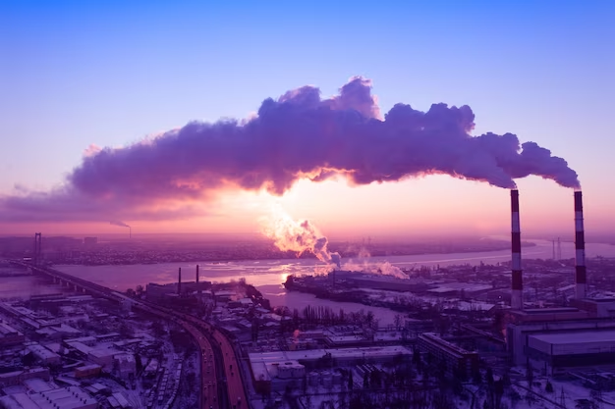
Image-to-Image Deep Learning for Climate and Weather Modelling
Mentors : Zeel B Patel, Prof. Nipun Batra
Members: Aditi Agarwal, Dheeraj Yadav, Rishabh Mondal, Sandeep Desai, Saumya Karan, Suraj Borate, Suraj Jaiswal,

Slide 2
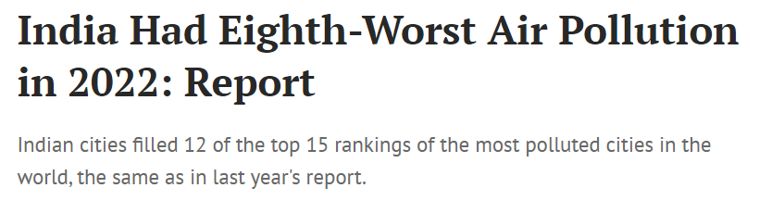
Motivation
Source
Source

Slide 3
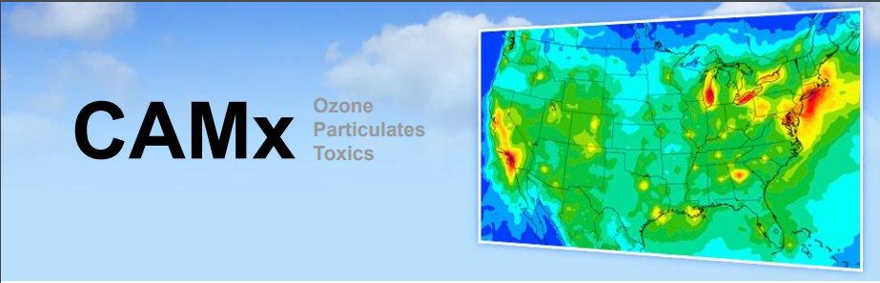
Work: CAMx, Chemical Transport Model (Ramboll. 2019)

Slide 4


Motivation
Example of a dispersion model for modelling air quality(CMAQ)
Time complexity for solving the equation
The compute is extremely expensive and time consuming

Slide 5
Problem Statement
Can we eliminate existing numerical method based air quality models like CAMx by replacing them with flexible and generalizable Deep Learning based models to enhance efficiency and produce instantaneous predictions?

Slide 6
Dataset Exploration

Slide 7
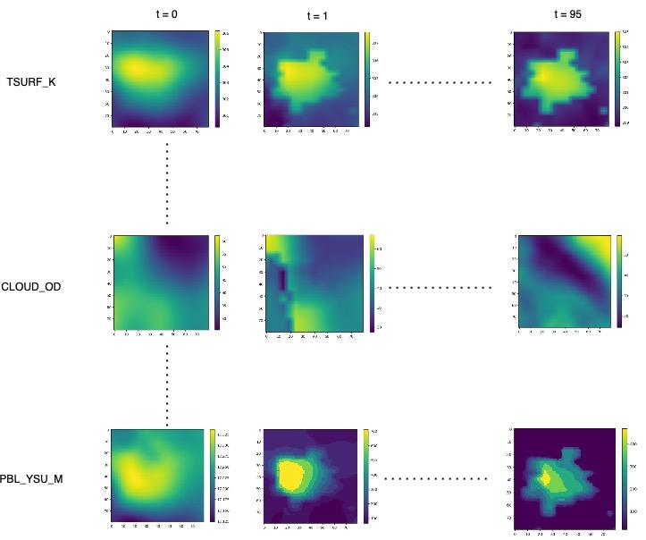
CAMx Meteorological Dataset
CAMx 96hr: 14 features(Input)
14 input features available as hourly 80*80 images across 96 hours
Features include metrics for temperature, pressure, wind speed, snow cover etc.

Slide 8
Normalized TSURF Data for 96 hrs

Slide 9
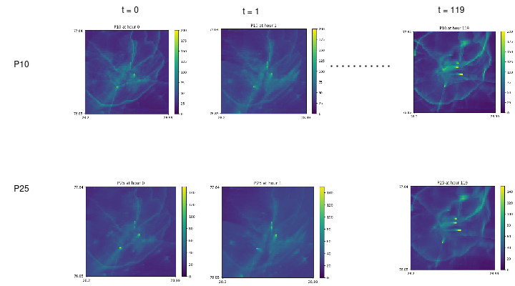
CAMx Meteorological Dataset
CAMx 120hr: 2 features
2 output features: P25: Concentration of pollutant PM 2.5
P10: Concentration of pollutant PM 1.0
Primary source of pollution and responsible for asthma, lung infections and premature death

Slide 10
Research Questions

Slide 11
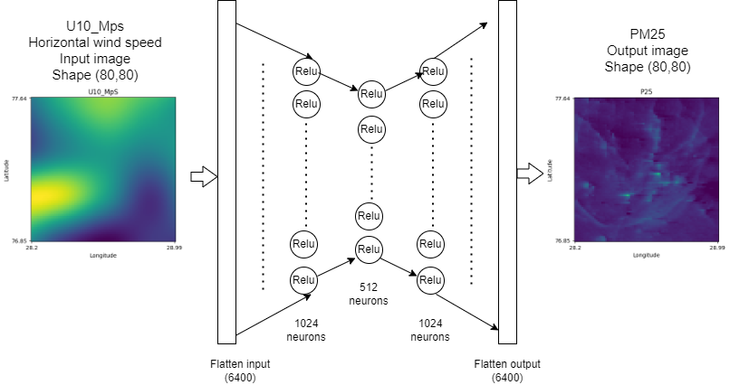
RQ1: Can we train a MLP AutoEncoder which uses a single channel as input?
AutoEncoder MLP Architecture

Slide 12
Experimental Setup
Epochs | 200
Optimizer | Adam
Batch Size | 32
LR | 0.001

Slide 13
RQ1: Can we train a MLP AutoEncoder which uses a single channel as input?
Input channel | MSE Loss of P10 and P25
V10_MpS | 0.4
U10_MpS | 0.7
SOLM_M3pM3 | 76.4
CLOUD_OD | 95.1
PRATE_MMpH | 275.4
SNOWEW_M | 275.5
T2_K | 275.8
CAPE | 276
SNOWAGE_HR | 276
PBL_WRF_M | 276.2
CLDTOP_KM | 276.8
PBL_YSU_M | 277.9
SWSFC_WpM2 | 280.9
TSURF_K | 296
Key Takeaways:
Horizontal wind speed, vertical wind speed, soil moisture content and opacity of clouds are important features for prediction of the particulate matter particles..

Slide 14
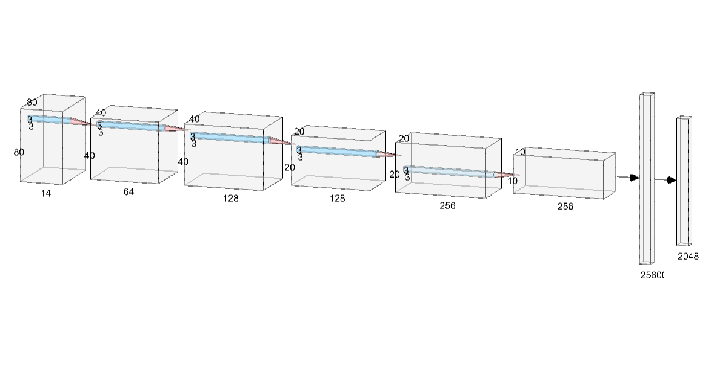
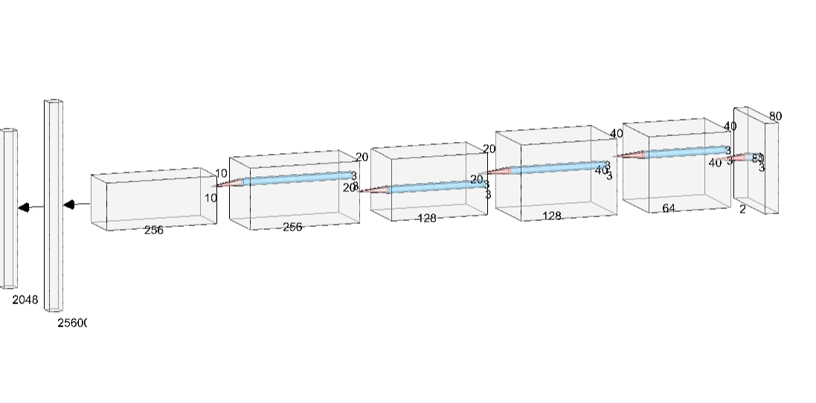
RQ2: Can we utilize a Convolutional Autoencoder which can take single as well as multiple input channels?
Convolutional Autoencoder Architecture
(input 14 channels -> output 2 channels)
Image shape: (80,80)

Slide 15
RQ2: Can we utilize a Convolutional Autoencoder which can take single as well as multiple input channels?
2.1 Single Channel Input
Input channel | Convolutional Autoencoder | MLP Autoencoder
U10_MpS | 6 | 0.7
SOLM_M3pM3 | 9.8 | 76.4
CLOUD_OD | 13.1 | 95.1
V10_MpS | 13.2 | 0.4
SWSFC_WpM2 | 278.9 | 280.9
CAPE | 279 | 276
T2_K | 279 | 275.8
PBL_WRF_M | 279.1 | 276.2
PRATE_MMpH | 281.1 | 275.4
TSURF_K | 282.4 | 296
SNOWEW_M | 282.6 | 275.5
CLDTOP_KM | 286.4 | 276.8
PBL_YSU_M | 288.6 | 277.9
Key Takeaways:
Both MLP Autoencoder and Convolutional Autoencoders have the same four features with the lowest MSE test loss.
These features are thus most important for PM concentration prediction.
Features like cloud cover and soil moisture witness a significant decrease in test loss but other features’ losses remain consistent.

Slide 16
RQ2: Can we utilize a Convolutional Autoencoder which can take single as well as multiple input channels?
2.2 All channel input
Key Takeaways:
Convolutional layers in the Autoencoders significantly decrease the loss
MSE Loss: 20.457

Slide 17
RQ3: Can we utilize UNet architecture across single and multiple channel inputs?
Why?
To improve CNN autoencoders we cannot add more layers since it leads to degradation problem
UNet(Ronneberger et. al. 2015) solves this by using a similar architecture but introducing skip connections which help "remind" the network of what it was trying to learn initially.
Skip connections retain spatial information

Slide 18
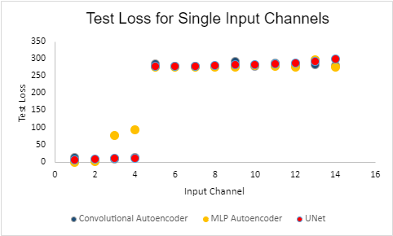
RQ3: Can we utilize UNet architecture across single and multiple channel inputs?
3.1 Single channel input
Input channel | Convolutional Autoencoder | MLP Autoencoder | UNet
V10_MpS | 13.2 | 0.4 | 5.8
U10_MpS | 6 | 0.7 | 10.1
SOLM_M3pM3 | 9.8 | 76.4 | 11.6
CLOUD_OD | 13.1 | 95.1 | 12.4
Input Channels with the lowest test loss

Slide 19
RQ3: Can we utilize UNet architecture across single and multiple channel inputs?
3.2 All channel input
Key Takeaways:
Addition of skip connections significantly reduces the MSE test loss.
CNN AE MSE Loss: 20.457
UNet MSE Loss: 3.9575

Slide 20
RQ4: Can we use only a subset of the channels for training?
 | Convolutional Autoencoder |  | UNet
 | All channels | Subset of Channels(4) | All channels | Subset of Channels(4)
Test Loss | 20.457 | 3.3631 | 3.9575 | 0.9041
Training Time | 14 min 3 sec (200 epochs) | 2 min 40 sec (100 epochs) | 13 min 15 sec (200 epochs) | 3 min 17 sec (100 epochs)
Parameters | 106,001,410 | 105,995,650 | 106,001,410 | 105,995,650
Note: In above table output channels are 2 (ie P10 and P25)across all.
Key Takeaways:
Using a subset of the “most important features” significantly decreases the test loss.
Utilization of a partial input also helps decrease computation time as well as memory.
Decreases likelihood of incorporating noisy and irrelevant information.

Slide 21
Conclusion
Thus, through a heuristic approach we are able to develop a data driven approach to model air quality.
Utilization of a subset of the most important CAMx inputs for training provides the best results while also significantly reducing the training time and compute.
Introduction of skip connections(UNet) in an existing convolution architecture significantly improves the model performance.

Slide 22
Thanks

